Slide 1
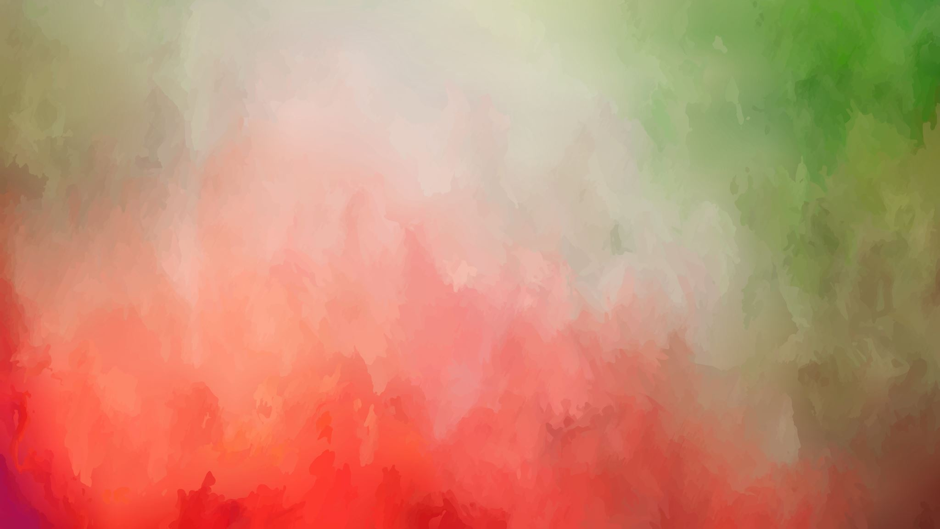
Neural Style Transfer
Sai Lokesh Gorantla
20IE10028

Slide 2
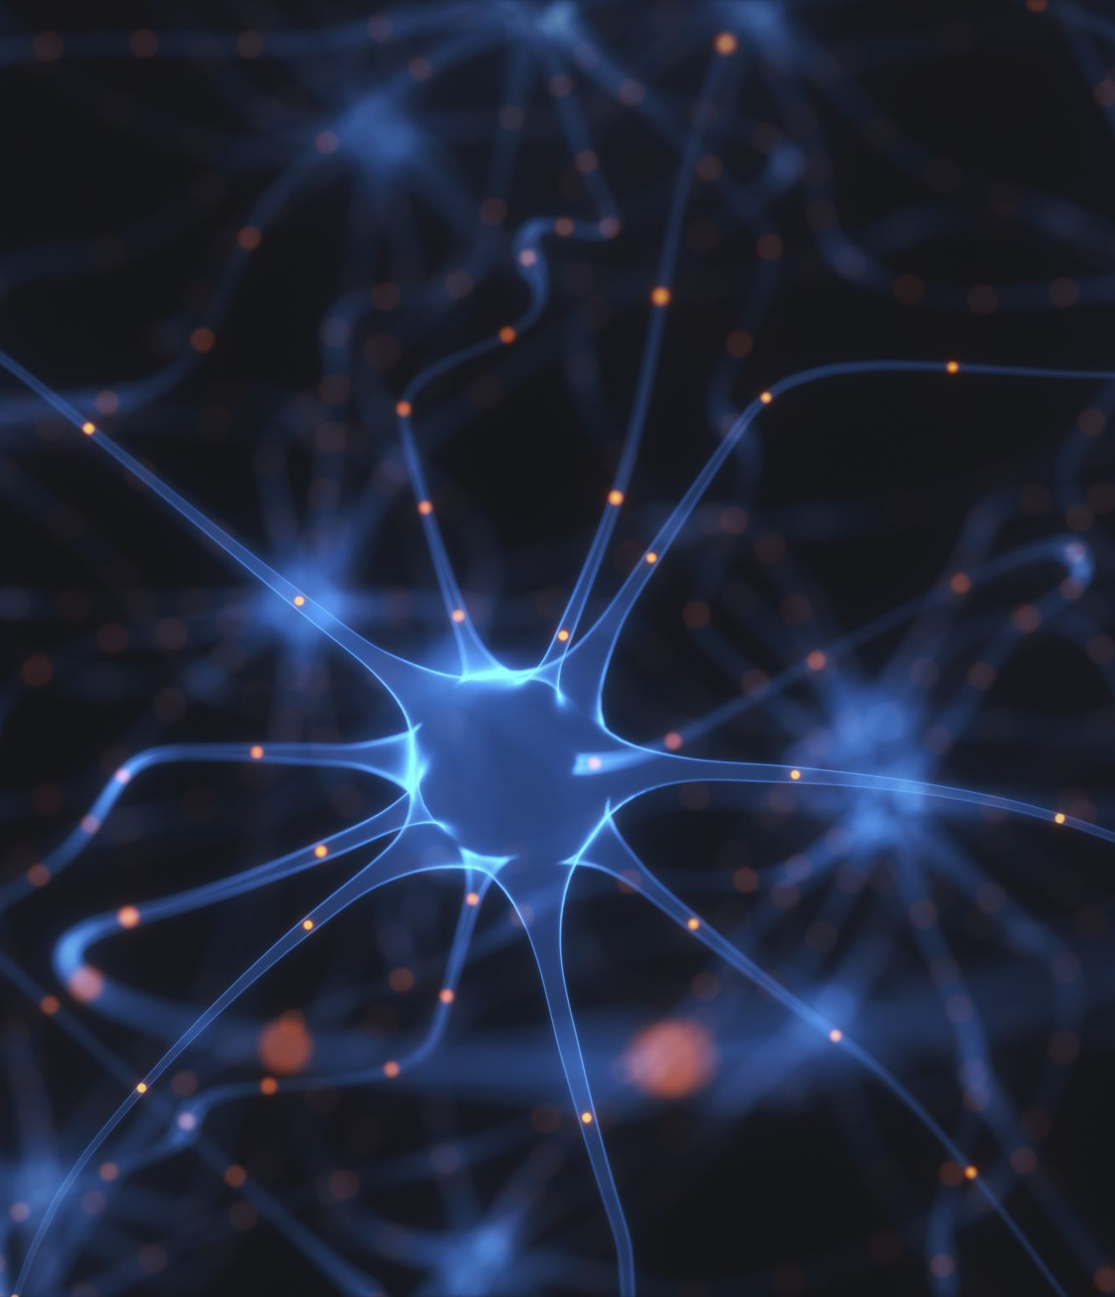
Introduction
Neural Style Transfer is one of the beauties of Neural Networks which lets us to apply the style used in a painting to another picture
Helps in creating artificial artworks from paintings
Data augmentation is a critical use-case*
Entertainment and social communication*
* Explained in the later slides

Slide 3
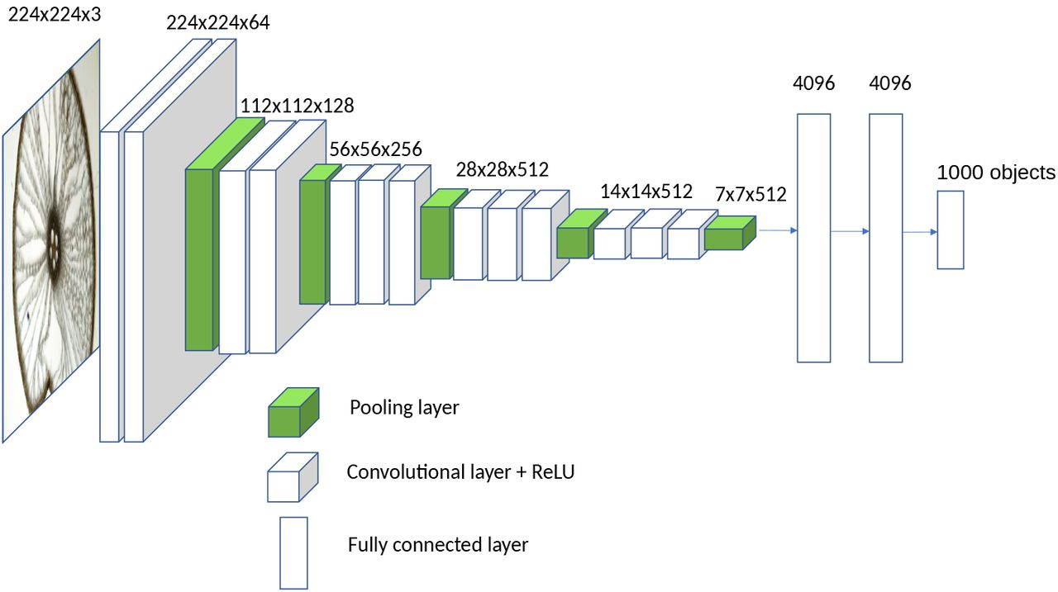
The VGG 16 Architecture

Slide 4
Cost function and optimization
J = α * J(C,G) + β * J(S,G)
J_{content} = J(C,G) = ΣΣ(a_{ij}^{(C)} – a_{ij}^{(G)})²
'a' represents the activation
J_{style} = J(S,G) = (1/(2*n_{H}*n_{W}*n_{C})) * ΣΣ(G_{ab}^{(S)} - G_{ab}^{(G)})²
G_{ab}^{(S)} = ΣΣ a_{ij}^{(S)}*a_{ij}^{(S)} — Gram matrix of Style Image
G_{ab}^{(G)} = ΣΣ a_{ij}^{(G)}*a_{ij}^{(G)} — Gram matrix of Generated Image
Apply gradient descent over the generated image: dJ/dG
[Gatys et al., 2015. A neural algorithm of artistic style]

Slide 5
How to generate the image
Initiate the generated image with random values
Pick a layer (preferably middle) from the VGG model to find the activations
Calculate content and style costs
Tune the parameters α and β to obtain required results
Run the gradient descent over Generated image, unlike on the weights as in a NN G = G - α * dJ(G)/dG
Try choosing a different layer and repeat these steps until we get a satisfactory result

Slide 6
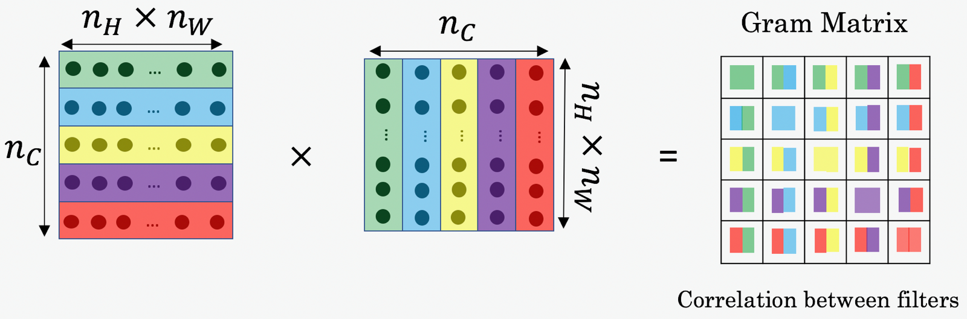
Gram Matrix
The gram matrix is a square matrix that contains a dot of each vectorized filter in layer 'l'.

Slide 7
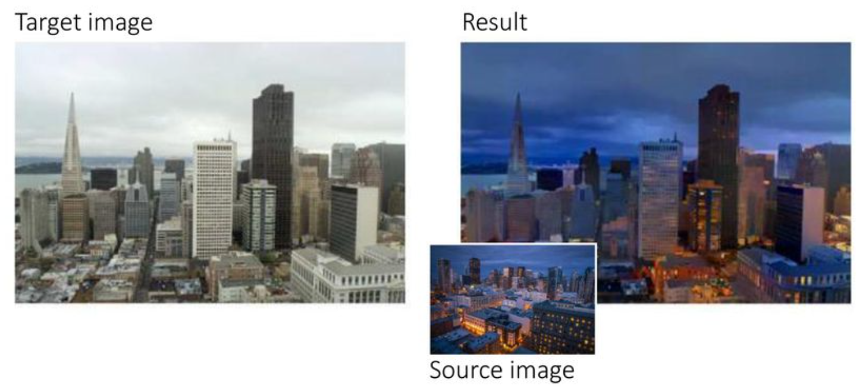

Slide 8
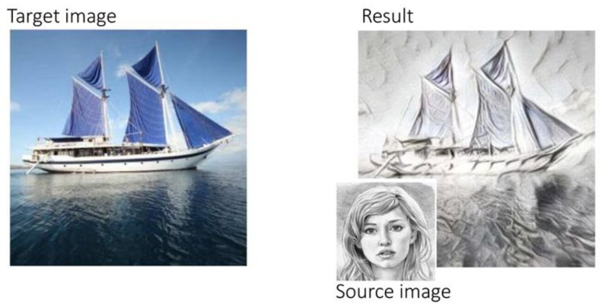

Slide 9
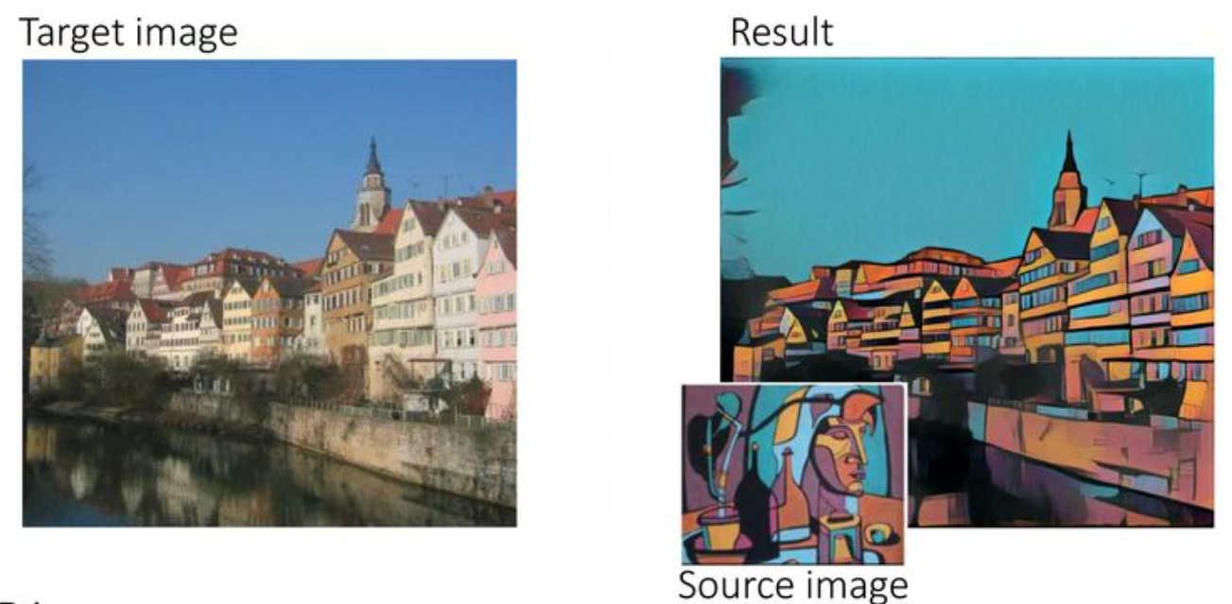

Slide 10
